Slide 1



WELCOME
SRISHTI 2024
components
survey
about
10TH NATIONAL LEVEL TECHNICAL PROJECT EXHIBITION & COMPETITION

Slide 2
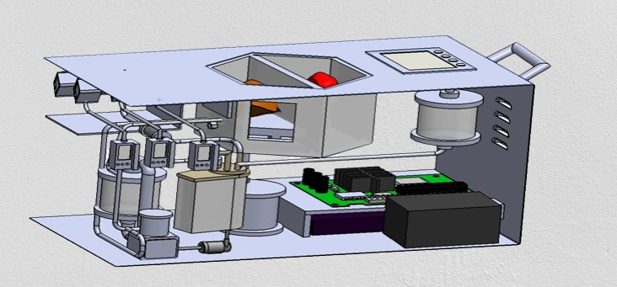
Components
survey
about
PROLONGED PRESERVATION OF HUMAN LIVER USING NORMOTHERMIC MACHINE PERFUSION PROCESS

Slide 3
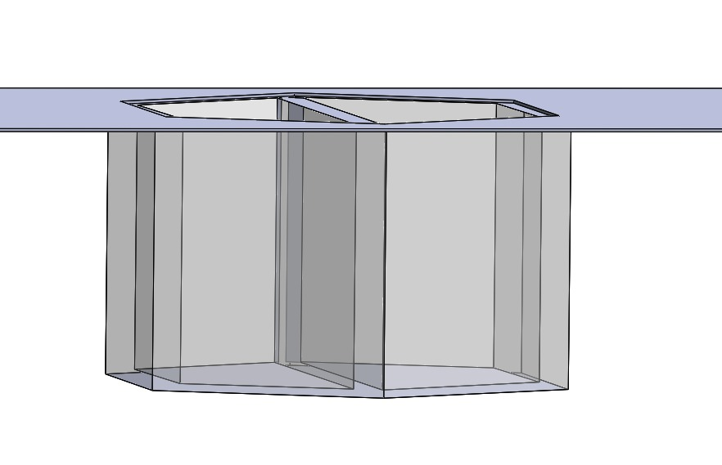
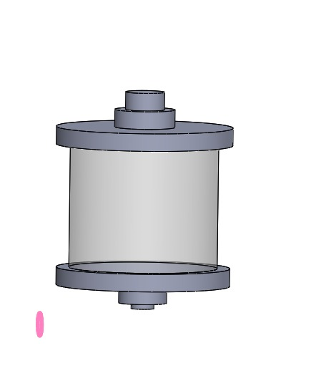
Organ Basin
Cleanser Unit
Cleaning and Filtering the organ Basin before and after it is used to preserve the organ.
survey
about
components
Hold the Organs and protects the organs from Physical Trauma.
Cleaning and Filtering the organ Basin before and after it is used to preserve the organ.

Slide 4
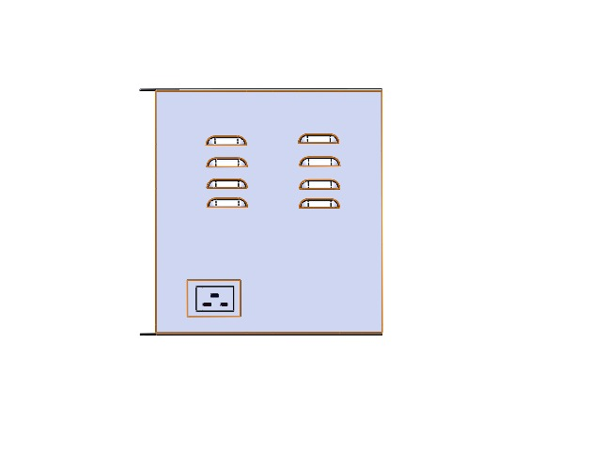
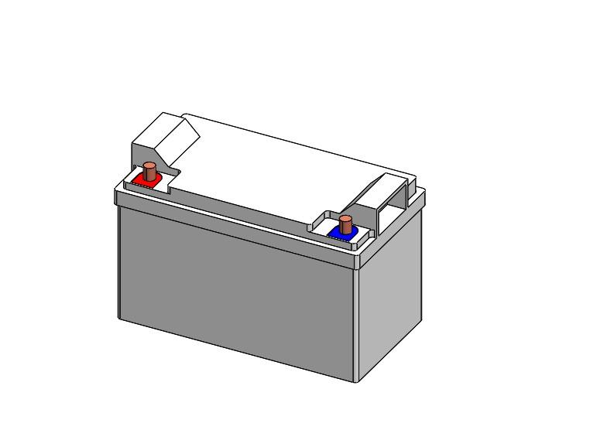
AIR FILTERS
PMS UNIT
Heaters
Air Filters remove the Carbondioxide and other waste gases from the perfusion System
Responsible for Managing and Supplying Power to Machine Perfusion Process.
Keep the organs at a specific Temperature during Transportation from the donar to the Recipient
Air Filters remove the Carbon-di-oxide and other waste gases from the perfusion System
Responsible for Managing and Supplying Power to Machine Perfusion Process.

Slide 5
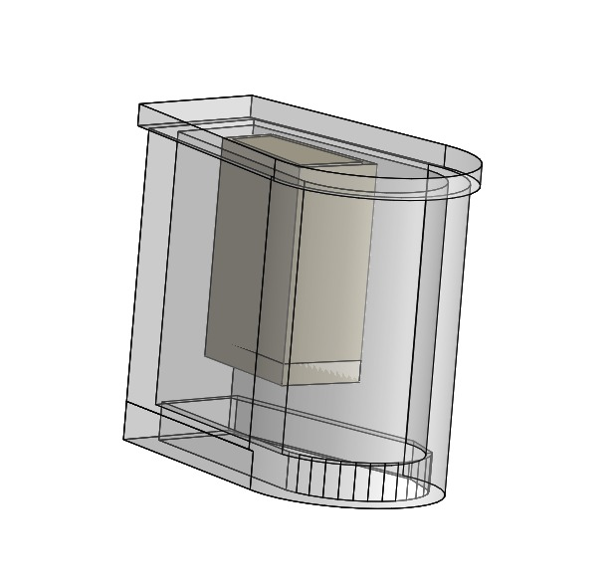
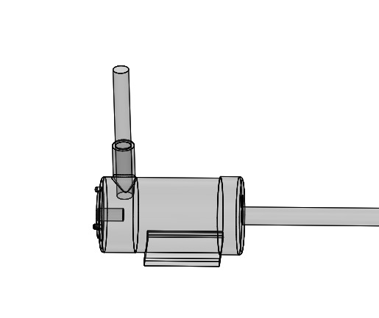
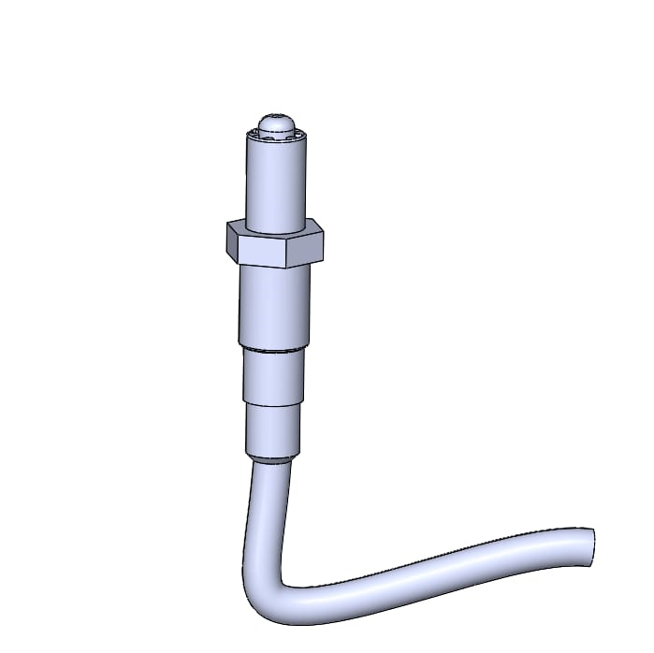
Reservoir
ROTAFLOW PUMP
IV INFUSION PUMP
store and Protect the Liver during Transportation from the donal to the recipient.
Medical Device designed for Extracorporeal Life Support Systems(ECLS) such as Extracorporeal Membrane Oxygenation(ECMO)
Medical Device designed for Extracorporeal Life Support Systems(ECLS) such as Extracorporeal Membrane Oxygenation(ECMO)
Deliver a Therapeutic solutions to the Preserved organs ensuring it receives essential Nutrients and Medications to maintain its Function during the Perfusion Process.
Store and Protect the Liver during Transportation from the donal to the recipient.

Slide 6
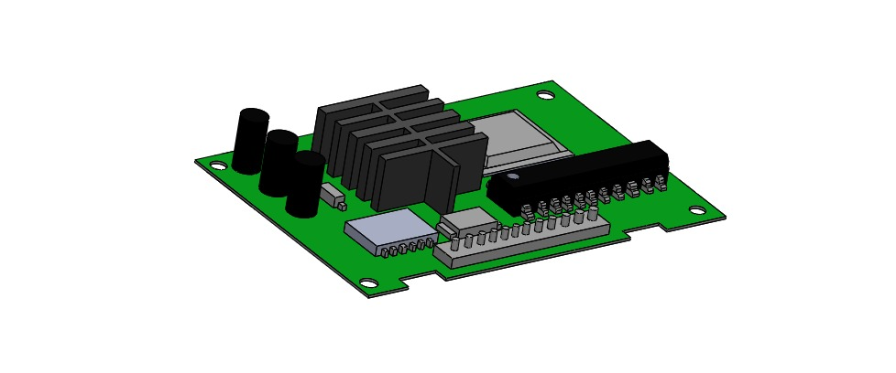
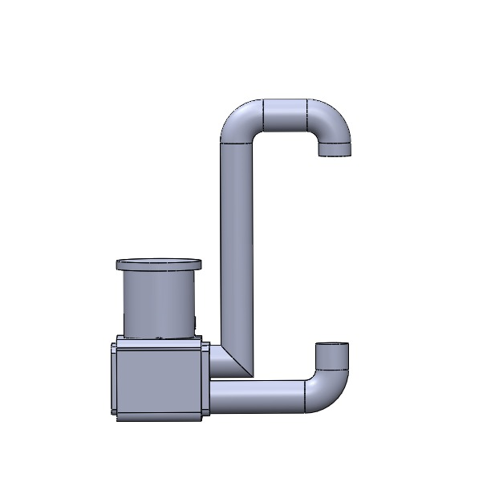
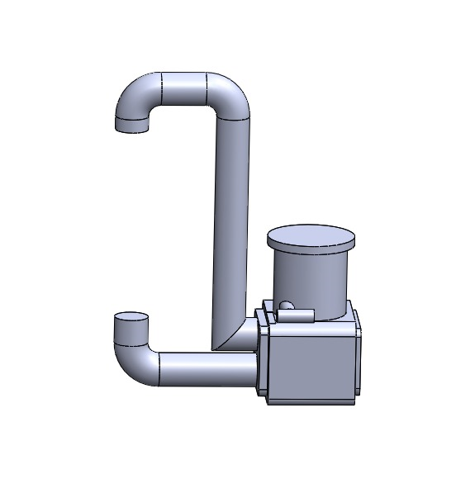
Medication Probe
PV Infection
HA Infusion
Dilate the Blood vessels and improve Blood Flow through the organ
The discarded human organ is connected to perfusion machine through its blood vessels,Including the portal vein.
It reduces the Inflammation and oxidative Stress during Organ Preservation,potential improve Organ function.

Slide 7
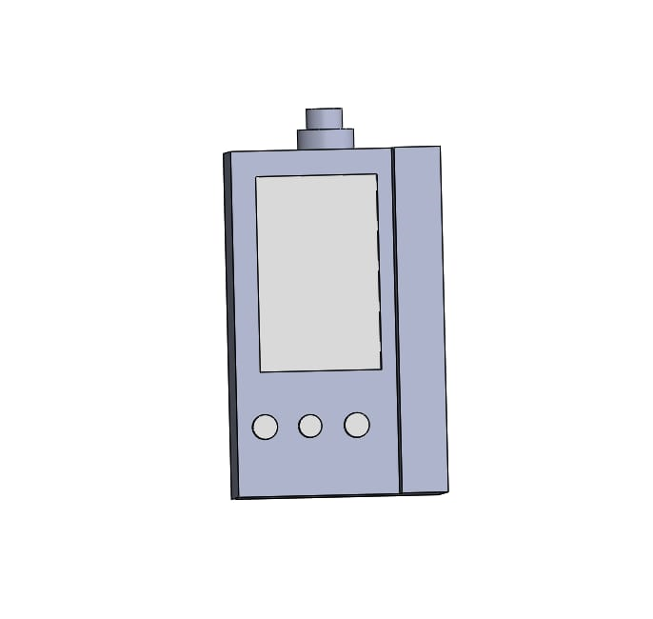
AUXILIARY PORT
Allow medical Professional to take Samples of the Perfusion Solution
Used to connect Various Monitoring devices to measure parameters such as Oxygen levels,Pressure and Temperature.

Slide 8



Components
Survey
about
1-Day
30-Day
1-Year
0.9%
3.5%
8.6%

Slide 9
